Slide 1
Business Insights Dashboard Overview and Analysis

Slide 2
Business Insights Dashboard Overview and Analysis
Dashboard for Business Insights
KPIs and Filters Used
Dashboard Screenshot
Key Insights

Slide 3

Dashboard for Business Insights
Title Slide Design: Incorporate main title prominently with balanced spacing to enhance immediate audience engagement.
Presenter Identification: Include presenter's full name below title using professional font style for clear association and credibility.
Visual Hierarchy: Apply typographic hierarchy to differentiate title and name ensuring clarity and aesthetic coherence.
Generated on AIDOCMAKER.COM

Slide 4
KPIs and Filters Used
Sales Revenue: Quantifies total income from sales, serving as fundamental indicator for evaluating overall business growth.
Customer Acquisition Cost: Measures average expense incurred to acquire a new customer, optimizing marketing and sales budget allocation.
Data Filters: Date ranges, geographic regions, and product categories refine dataset enabling precise, targeted performance analysis.

Slide 5
Dashboard Screenshot
Dashboard Screenshot Quality: Employ high-resolution capture ensuring all charts, tables, and graphs are sharp and legible in detail.
Visual Focus: Crop tightly to emphasize key KPI visuals, eliminating peripheral distractions and enhancing interpretability.
Layout Consistency: Maintain uniform spacing and alignment to facilitate seamless understanding of complex dashboard information.

Slide 6
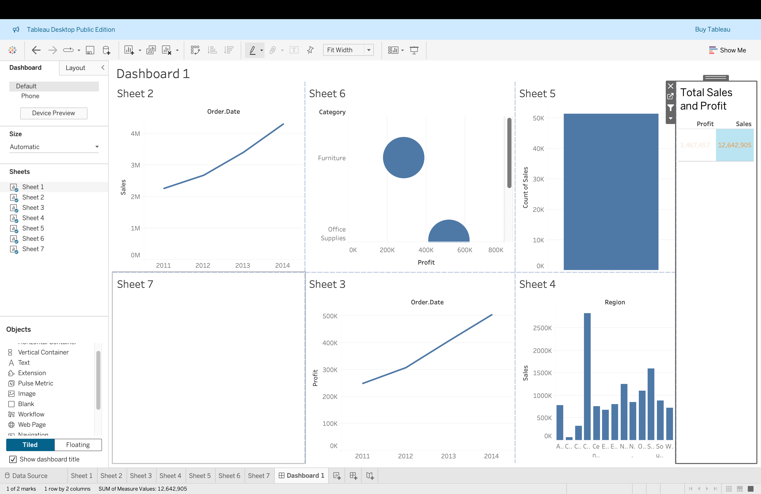

Slide 7
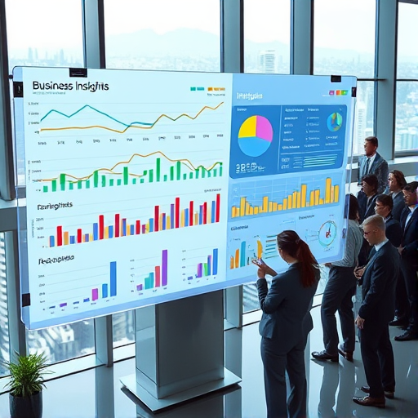
Key Insights
Revenue Growth in Q4: Q4 exhibited a remarkable 15% revenue increase compared to Q3, signaling robust market performance.
Reduced Customer Acquisition Cost: Customer acquisition expenses declined by 10% over six months, enhancing marketing cost-efficiency significantly.
Emerging Seasonal Trends: Analysis revealed consistent seasonal revenue spikes, indicating predictable cyclical demand fluctuations across quarters.
Generated on AIDOCMAKER.COM

